Slide 1





Head Impact Exposure from Match Participation in Women’s Rugby League over one Season of Domestic Competition
Authors: Doug King (PhD), Patricia Hume (PhD), Conor Gissane (PhD), David Kieser (PhD) & Trevor Clark (PhD)
2020 RRIPG Summer Lecture Series
Presented by: Kiera Borthwick

Slide 2


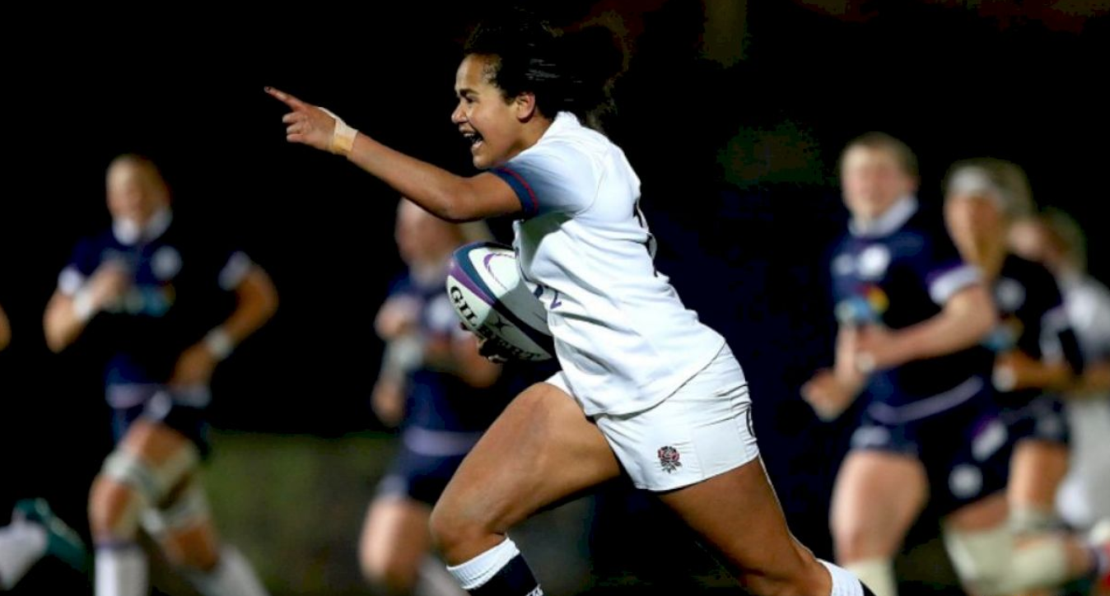
What was the purpose of the study?
Quantify magnitude, duration, distribution, and frequencies of head impacts in women’s rugby over the course of one competitive season.
Notes:
Concussion frequency: 7.7 per 1000 playing hours.
Limited research on head impacts in women’s contact sports, and no research prior to this study on women’s rugby. Therefore, the focus was…

Slide 3
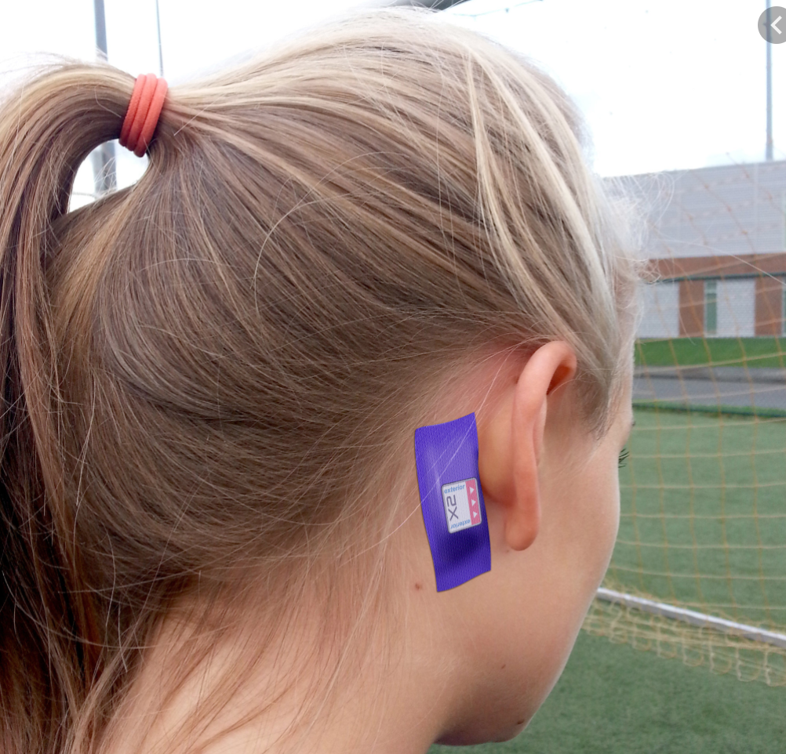

Methods: How was the study organized?
Prospective cohort study
21 players in 9 tournaments
Adhesive patch behind the ear
Notes:
Threshold of 10 grams, any impacts above this level were recorded by the device.

Slide 4
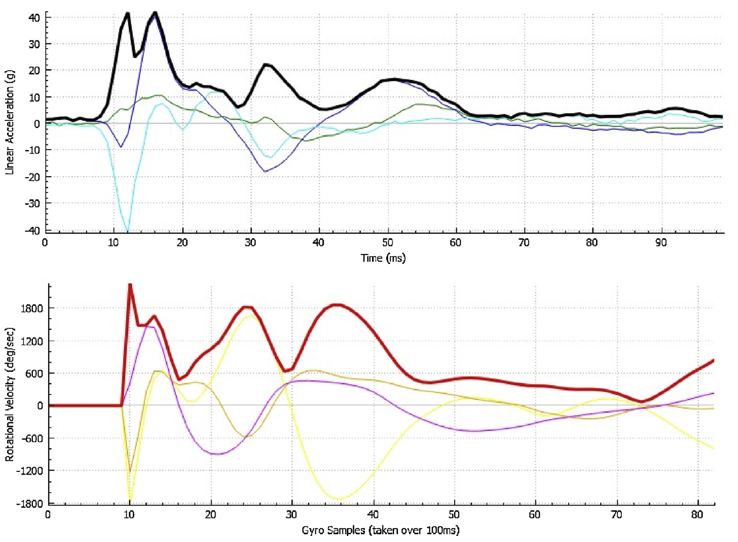
Methods: How was the study organized?
Peak Linear Acceleration (g)
Peak Rotational Acceleration (rad/s²)
Duration (ms)
Frequency
  By position, group, and match

Slide 5
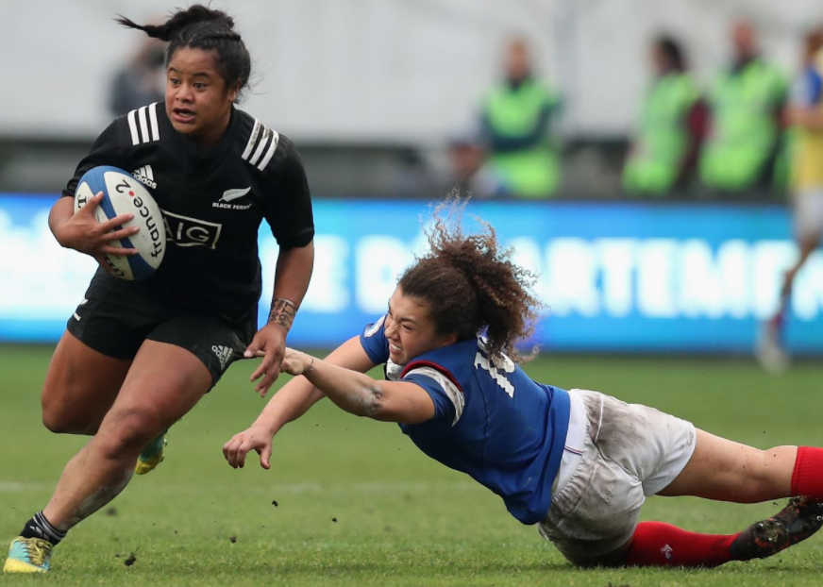
Overall Results
1659 total impacts
Linear Acceleration
Rotational Acceleration
Where and When?
Second half
Side of the head (n = 791)
Notes:
Repetitive sub-concussive impacts to the head. 3 Individuals had concussions.
LINEAR ACCELERATION: Median: 15g, 95th percentile: 41g (mild for both)
ROTATIONAL ACCELERATION: Median: 2886, 95th percentil: 9348 (mild, severe)
Second Half: more and longer duration impacts with higher linear and rotational accelerations
Side of the head: 300 more than any other location; this was true overall but not of each position group (outside backs had more contacts to the front of the head)

Slide 6
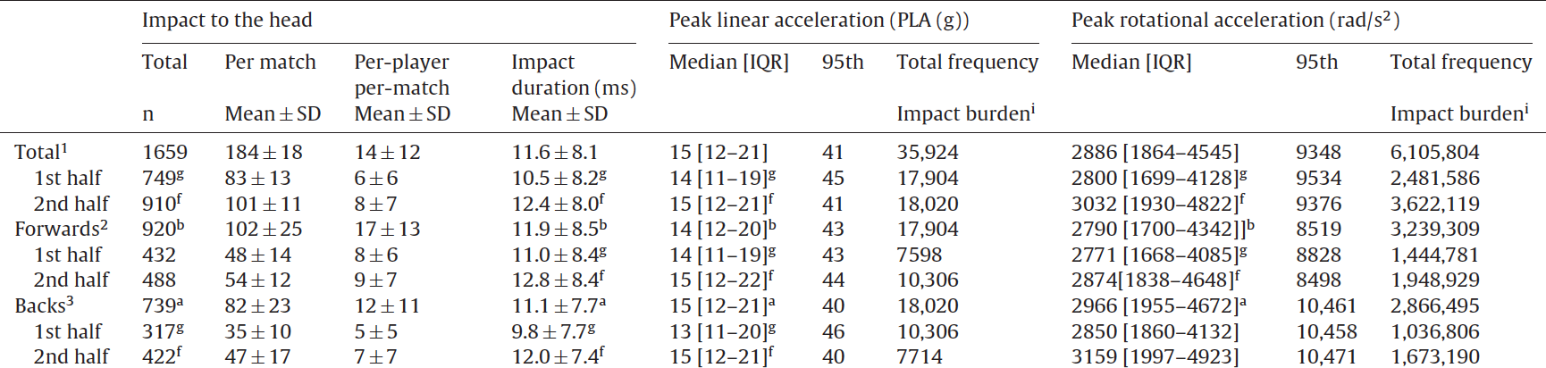
Results by Position
Forwards:
More impacts*
Higher impact duration
Backs:
Higher peak linear accelerations*
Higher peak rotational accelerations*

Slide 7
Discussion: How can we interpret these findings?
Context with inter-sport comparisons
Measure | Men’s Rugby | Junior Rugby | American Football | Youth Ice Hockey | Sub-elite Australian Football
Number of Impacts
Peak Linear Acceleration
Peak Rotational Acceleration
Impact Duration
Notes:
Note: the different styles of plays, rules, goals, and tackling techniques make these sports variable in terms of the types of contact they require. Although these comparisons are helpful for reference, its important to distinguish the differences between the sports. For example, tackles in rugby have a “twisting” element that is not seen in tackling techniques for American Football. This could generate higher peak rotational accelerations.
Additionally, different technology has been utilized for different sports. This device calculates the rotational acceleration, whereas other devices measure it directly. These differences are key to making inter-sport and inter-study comparsions.

Slide 8

Limitations
No video footage
Xpatch over-predicts accelerations

Slide 9
References
King, D. A., Hume, P. A., Gissane, C., Kieser, D. C., & Clark, T. N. (2018). Head impact exposure from match participation in women’s rugby league over one season of domestic competition. Journal of Science and Medicine in Sport, 21(2), 139-146. doi:10.1016/j.jsams.2017.10.026

Slide 10
Images
Finlan, J. (2018). Women's Six Nationals. Flo Rugby. https://www.florugby.com/articles/6126204-england- france-on-womens-six-nations-collision-course.
The X-Patch, a sensor from X2 Biosystems. (2013). New York Times.
https://www.nytimes.com/2013/06/16/business/a-wearable-alert-to-head-injuries-in-sports.html.
Women's Rugby Super Series. (2019). World Rugby. https://www.world.rugby/news/407839.
Kemp, B. (2018). Dangers of Rugby and Football. The Sports Geek. https://www.thesportsgeek.com/blog/rugby-football-more-dangerous-989/.

