Slide 1
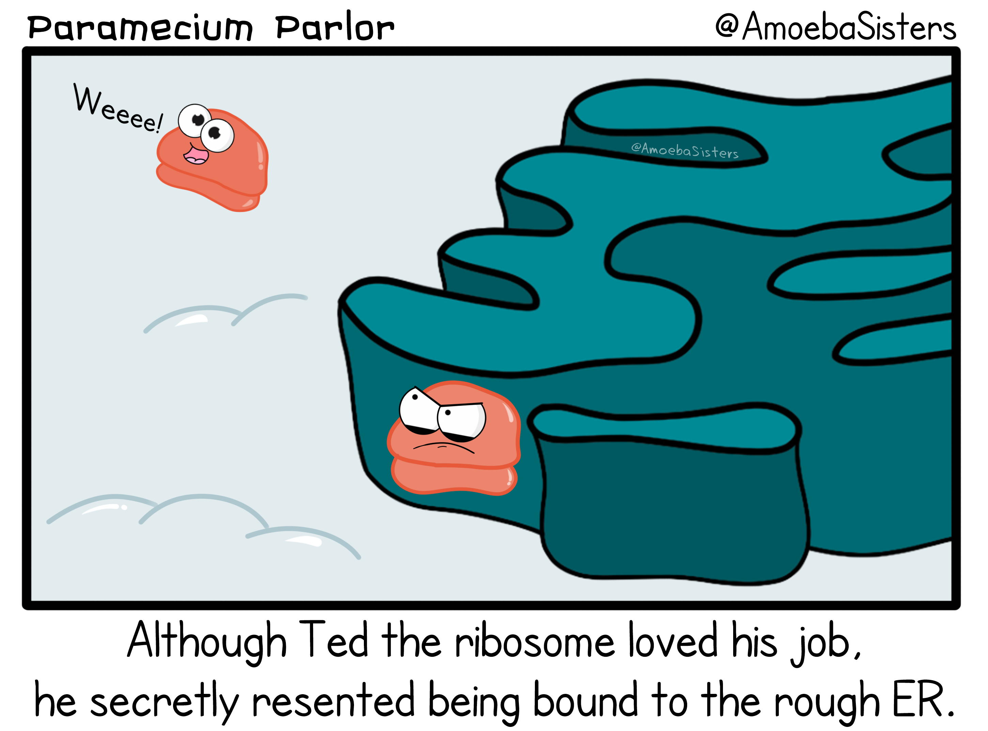
Codons and Code
Kiera Borthwick, Sherry Gu, Tara Kakkaramadam, and Sydney Tune

Slide 2
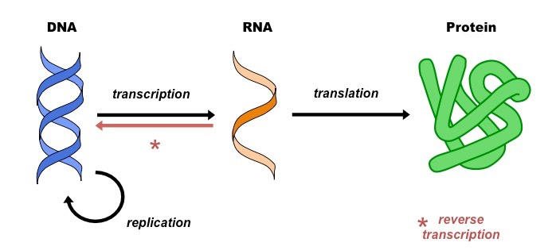
What is translation?

Slide 3
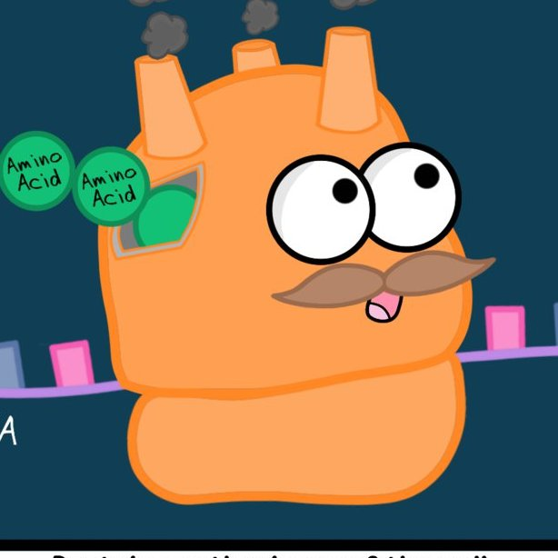
Translation occurs at the ribosome.
Nucleus
mRNA
START
STOP
mRNA
1. Initiation
2. Elongation
3. Termination

Slide 4
What is processivity?
START
STOP
mRNA
Processive: Full length protein made
STOP
mRNA
START
Non-Processive: Incomplete protein made

Slide 5


Where are we?
Current stage: understanding conditions that are affecting translation and processivity
  Mutants
  Growth conditions
  Translation Inhibitors
I AM THE KING!

Slide 6

How are we studying processivity?
Blue
Yellow
Red
Orange

Slide 7
Blue
Yellow
Red
Orange
GROWTH CURVES
Blue
Yellow
Orange
Red

Slide 8
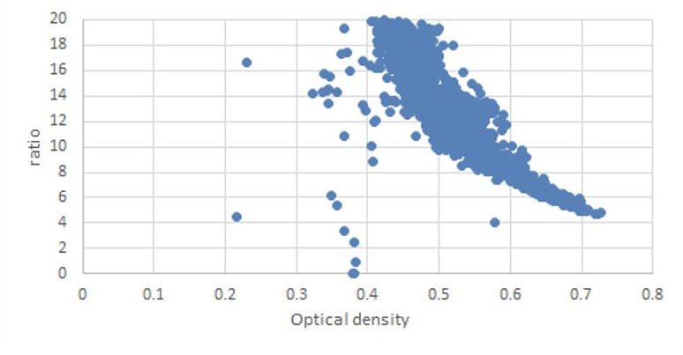
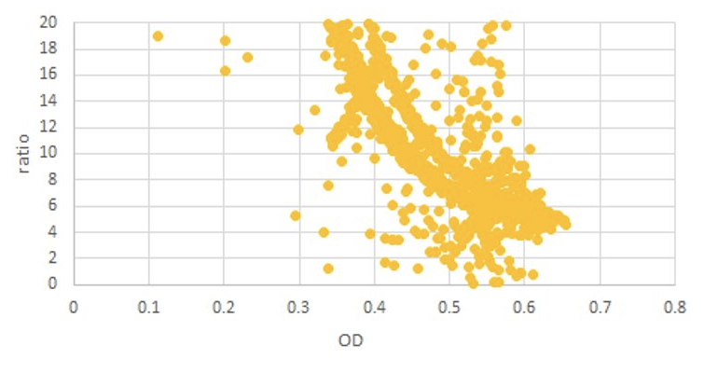

What are we seeing?
Normalized Blue Protein
Normalized Yellow Protein
Notes:
We are currently in the process of developing a model to better understand this data and its underlying biological significance.

Slide 9
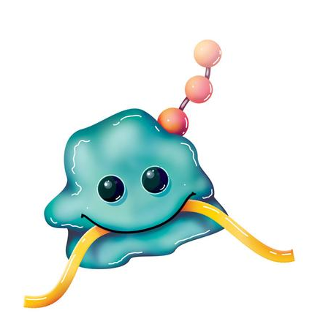
Where to from here?
Future Goals
  Proteins that regulate, boost, or inhibit processivity
  Mammalian cells
Impacts on the cell cycle and cellular growth

Slide 10

Acknowledgments
The SRS Program and the Jeffress Memorial Trust
Dr. J. Kyle Friend
Dr. Fred LaRiviere
Ben Peeples and Tori Hester
Dr. Natalia Toporikova
Our fellow SRS students and faculty
Any questions?

