Slide 1
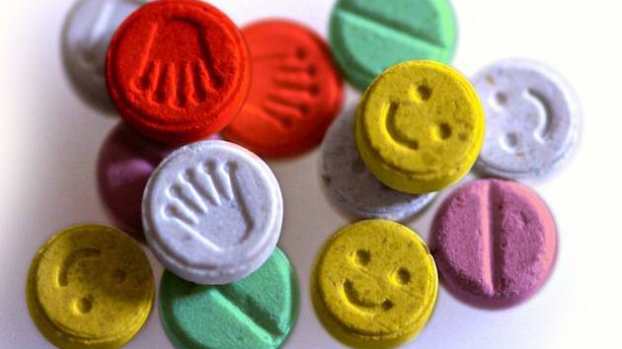
Ecstasy
Kiera Borthwick and Carissa Rodriguez
“MK-Ultra.” History, A&E Television Networks, 16 June 2017, www.history.com/topics/us-government/history-of-mk-ultra.
Notes:
Attention grabber about CIA using MDMA to “psychoactively” control people – essentially mind control. 1950s. Project Mk-ultra.

Slide 2
How does MDMA affect the body?
Neuron
Brain Structures
Whole Body
Immediate Effects
Long Term Effects
Notes:
We are going to explain what MDMA is and how it functions in the brain.
Out goal is to describe how serotonin works at the level of one synapse and how MDMA affects the synapse creating immediate effects. Then, we transition into the brain structures that serotonergic neurons innervate and how MDMA affects these brain regions to create its short term effects. Finally, we move to the broadest area and look at how MDMA affects the body on a bigger scale and the types of long-term impacts it can have on someone’s health and well-being.

Slide 3

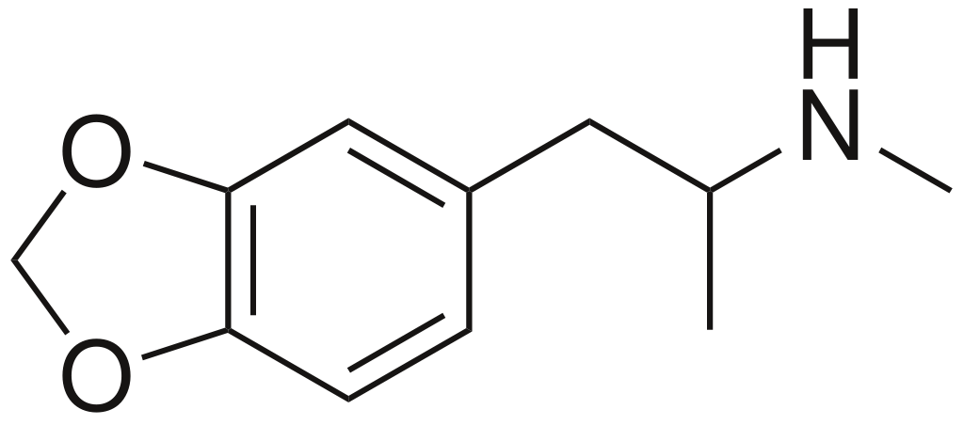
What is Ecstasy? MDMA?
"MDMA." Wikipedia.
"Ecstasy Tablets Ravejungle." Rave Jungle.
National Institute on Drug Abuse. “MDMA (Ecstasy/Molly).” NIDA, www.drugabuse.gov/publications/drugfacts/mdma-ecstasymolly.
Notes:
MDMA is the most basic form of Ecstasy. For our purposes they are identical.

Slide 4

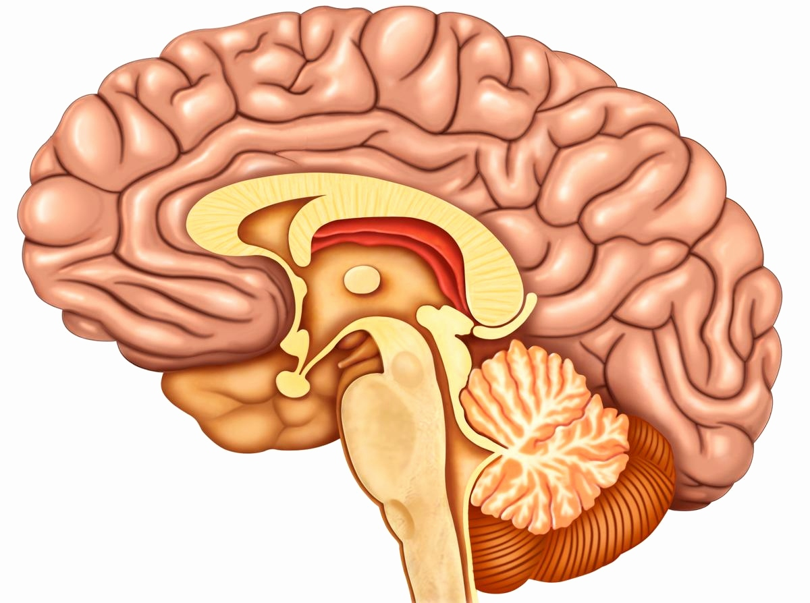
Where are we going in the brain?
“Sagittal Section of Human Brain.” ABDPVTLTD.
“Synapse” Clickr.

Slide 5



How Does Serotonin Normally Work at the Synapse?
Presynaptic Terminal
= serotonin
SERT
EXOCYTOSIS!
Synaptic Cleft
Rupp, Marlene. “Psychedelic Drugs and the Serotonergic System.” Sapiensoup Blog, 31 May 2017, sapiensoup.com/serotonin.
Notes:
Mention that serotonin is a neurotransmitter.

Slide 6
How Does Serotonin Work When MDMA is Present?
Presynaptic Terminal
2
= serotonin
= MDMA
SERT
3
Synaptic Cleft
1
4
Rupp, Marlene. “Psychedelic Drugs and the Serotonergic System.” Sapiensoup Blog, 31 May 2017, sapiensoup.com/serotonin.
Notes:
Steps to Explain:
Ecstasy enters the presynaptic neuron from the cleft through the channel protein SERT. SERT is normally involved in reuptake of the NT serotonin from the cleft.
MDMA removes serotonin from vesicles and inhibits Vesicular Uptake Transporters, VMATs in this case, that put serotonin into vesicles.
With greater amounts of free flowing serotonin in the cytoplasm and not in vesicles, the MDMA reverses the flow of the SERT channels which now can transport serotonin out of the cell into the cleft, opposite of what would normally happen. This massively increases the levels of serotonin in the cleft.
There is lots more serotonin in the cleft which binds more frequently to receptors in the post synaptic cell and causes increased excitation. These effects last for as long as MDMA is active in the body. It is most active for about 7 hours, its half life.

Slide 7
Where are we going in the brain?

Slide 8




How Does MDMA Affect Serotonin Pathways?
“Loss of Appetite.” How to Stop Being Hungry Quickly.
“Thinking Brain Machine Vector Clipart.” Free Photos and Images, 2018.
“Sagittal Section of Human Brain.” ABDPVTLTD.
“Smiling Face.” The Happy Folk at Bree, 2013.
“Mouth.” Girls Love Style.
National Institute on Drug Abuse. “MDMA (Ecstasy/Molly).” NIDA, www.drugabuse.gov/publications/drugfacts/mdma-ecstasymolly.
Notes:
Notes:
Serotonergic neurons originate in an anatomical structure known as the raphe nuclei, in the midbrain. From the raphe nuclei, the neurons spread all over the brain to areas including the neocortex, amygdala, hypothalamus, and even down into the spinal cord.
CLICK ONE: neocortex. The neocortex is a large region of the brain responsible for higher level thinking, processing, memory, and perceptions. When serotonergic neurons that go to the neocortex are over stimulated after consumption of the drug, individuals can have impaired perception, clouded judgement/thinking. This region of the brain is what creates the seemingly hallucinogenic effects many ecstasy users experience.
CLICK TWO: spinal cord. The spinal cord carries signals from the brain down to the peripheral nervous system, including those for motor movements. When serotonergic neurons going here are over stimulated by ecstasy it can affect movement and muscle contraction and often results in jaw clenching, what might seem like an unexpected or strange symptom of ecstasy use.
CLICK THREE: hypothalamus. The hypothalamus is responsible for homeostatic functions, it links the nervous system to the endocrine system through the pituitary gland, as we know, and is important in body functions including circadian rhythms, hunger, and body metabolism. When serotonergic neurons from the raphe nuclei to this region are overstimulated, this can often lead to decreases in appetite.
CLICK FOUR: hippocampus. The hippocampus is important in the formation of new memories. When serotonergic neurons are overstimulated in the hippocampus it impacts memory formation, so a lot of individuals on ecstasy have trouble with memory recall or cannot remember events while they are on the drug.
CLICK FIVE: amygdala. Amgydala is an important structure in the limbic system. When serotonergic neurons that innervate the amygdala are overstimulated it creates the feelings of elation and extreme happiness that ecstasy users experience.
MDMA can also impact the body long-term.
Spinal cord: purple (https://www.girlslovestyle.com/bruxism/)
Neocortex: green (https://www.goodfreephotos.com/vector-images/thinking-brain-machine-vector-clipart.png.php)
Hippocampus: blue (https://www.vectorstock.com/royalty-free-vector/brain-light-bulb-vector-278419)
Hypothalamus: Red (https://www.wikihow.com/Stop-Being-Hungry-Quickly)
Amygdala: Pink (https://www.macrobusiness.com.au/2013/03/the-happy-folk-at-bree/)

Slide 9
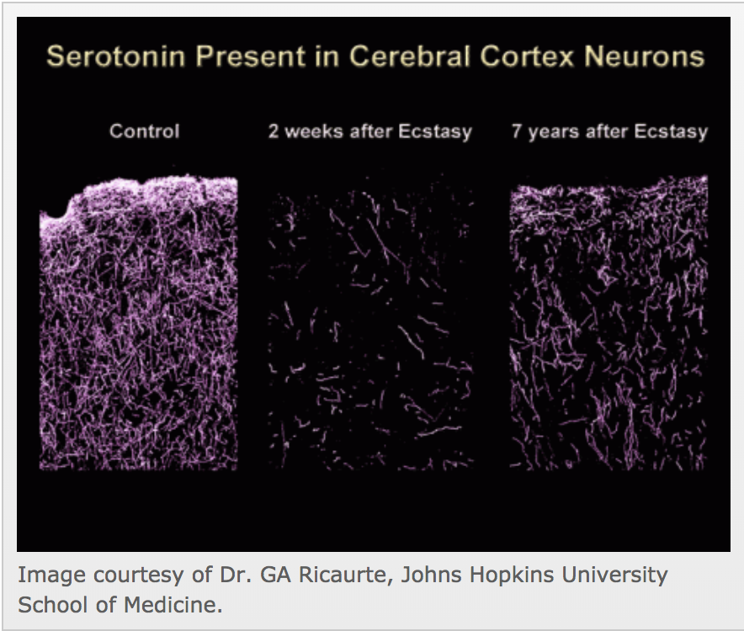
Can MDMA Affect the Body Long Term?
"Long term effects in monkeys." Dr. GA Ricaurte, Johns Hopkins University School of Medicine.
CONTROL
2 WEEKS AFTER ECSTASY
7 YEARS AFTER ECSTASY
National Institute on Drug Abuse. “MDMA (Ecstasy/Molly).” NIDA, www.drugabuse.gov/publications/drugfacts/mdma-ecstasymolly.
Notes:
MDMA drastically affects serotonin levels in the brain. This image is from a study with monkeys where the monkeys were given MDMA twice a day for four days. The box on the right shows monkeys who were not given ecstasy and the other two boxes show the monkeys given ecstasy 2 weeks and 7 years after the ecstasy use. These are photomicrographs of brain sections that have dyed the serotonin neurons. As you can see the number of serotonin neurons drastically decreases after use of ecstasy and the damage remains even 7 years after use. Too much is released when someone is on the drug and the brain cannot make enough to compensate for the loss. → leads to depression a few days after the “high” ends.

Slide 10



Recap: What is Ecstasy?
“CIA Logo” Bbwbettiepumpkin.
“Therapy” Abuti Rams Consultancy.
“Party Drugs” Jeadline.
“MK-Ultra.” History, A&E Television Networks, 16 June 2017, www.history.com/topics/us-government/history-of-mk-ultra.
Notes:
Remember from the beginning when we mentioned that the CIA tried to use ecstasy for “mind control” in the 1950s. Well the usage of ecstasy has certainly evolved since then. In the 1970s psychiatrists used it with patients to make them more willing to talk. Now, it is often used amongst college students and partygoers. The usage of the drug has changed drastically over the past few decades, and it is important we learn about its effects on the brain.
We discussed how ecstasy works in the brain and creates short, medium, and long term effects. Ecstasy is a drug in a class of its own. IT completely reverses the flow at the synapse, affects multiple brain structures, and causes permanent long-term damage to neurons.

Slide 11
References
“MK-Ultra.” History, A&E Television Networks, 16 June 2017, www.history.com/topics/us-government/history-of-mk-ultra.
National Institute on Drug Abuse. “MDMA (Ecstasy/Molly).” NIDA, www.drugabuse.gov/publications/drugfacts/mdma-ecstasymolly.
National Institute on Drug Abuse. “The Neurobiology of Ecstasy (MDMA).” NIDA, www.drugabuse.gov/publications/teaching-packets/neurobiology-ecstasy/section-i/1-introduction-long-term-effects-ecstasy.
Rupp, Marlene. “Psychedelic Drugs and the Serotonergic System.” Sapiensoup Blog, 31 May 2017, sapiensoup.com/serotonin.
“3,4-Methylenedioxymethamphetamine.” National Center for Biotechnology Information. PubChem Compound Database, U.S. National Library of Medicine, pubchem.ncbi.nlm.nih.gov/compound/mdma#section=Top.

