Slide 1
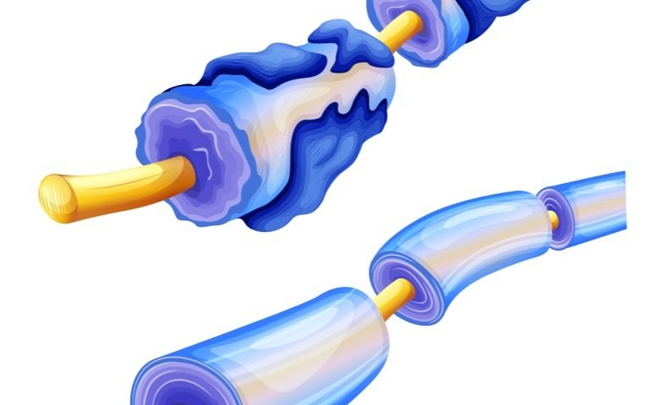
Multiple Sclerosis
Kiera Borthwick
Notes:
Image:
https://charcot-marie-toothnews.com/2018/09/17/charcot-marie-tooth-type-x-possible-risk-factor-multiple-sclerosis/

Slide 2






“What does MS mean to you?”
2.3 million people
“Fighting for my future”
“I may not look sick on the outside, but on the inside it’s like my body is trying to kill me”
”World Map.” Clicker Clipart
“An uncertainty about tomorrow”
“It's Multiple Sclerosis Week! Tell Us What MS Means to You.” National Multiple Sclerosis Society, main.nationalmssociety.org/site/MessageViewer?em_id=68686.0&dlv_id=86366&s_AffiliateSecCatId=1&pw_id=10481.
Notes:
http://main.nationalmssociety.org/site/MessageViewer?em_id=68686.0&dlv_id=86366&s_AffiliateSecCatId=1&pw_id=10481
It’s easy to look at the statistics… 2.3 million people have multiple sclerosis in the world today. That means 3 out of every 10,000 people have multiple sclerosis.
The statistic can tell you a lot, but they don’ tell the whole story. Suffering from MS is more than just a statistic.
When asked what MS means to them, current patients say that MS means…
“fighting for my future” “uncertainty about tomorrow” ““I may not look sick on the outside, but on the inside it’s like my body is trying to kill me”
Person images:
http://www.clker.com/clipart-pink-stick-man.html
Map image:
https://desenio.com/us/artiklar/poster-world-map-black-white.html

Slide 3
Cellular processes, symptoms, and disease progression help create treatment options.
Treatment Options
Cellular Degradation
Symptoms
Progression
Notes:
ONE LINE THESIS: The processes of cellular degradation, physical symptoms, and disease progression all culminate to help in the development of new treatment options for MS.
I plan to review these three main topics, and show the treatment options we have created from our knowledge in all these areas. Hopefully, these treatment options may eventually lead to a more permanent cure.

Slide 4
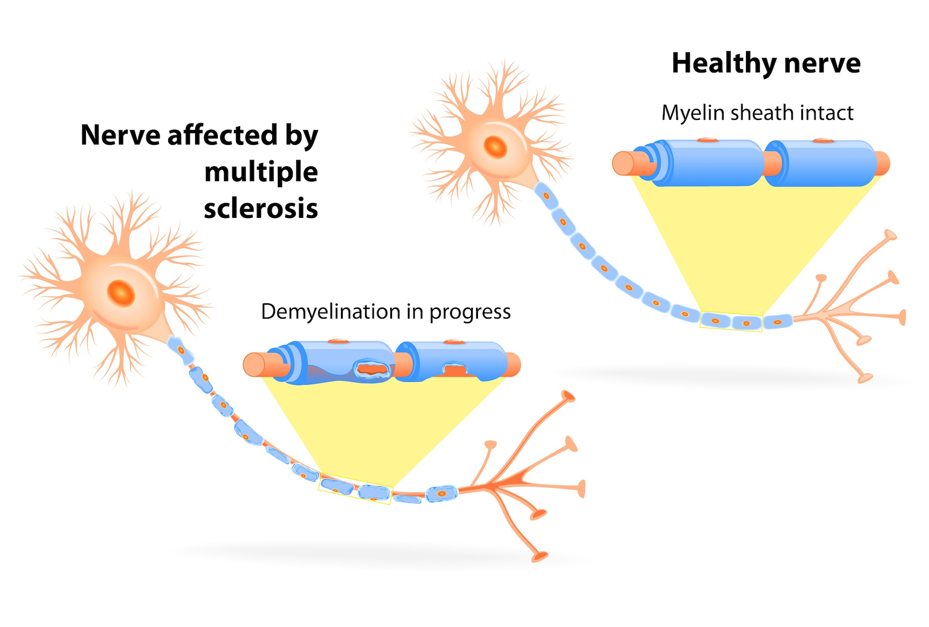
What is Multiple Sclerosis?
“Multiple Sclerosis Myelin Sheath Cartoon.” Gene.
“Multiple Sclerosis.” Genentech, www.gene.com/patients/disease-education/multiple-sclerosis?topic=multiple-sclerosis.
Notes:
https://www.gene.com/patients/disease-education/multiple-sclerosis?topic=multiple-sclerosis
“Multiple Sclerosis is a chronic and progressive disease of the nervous system that damages the myelin sheath (fatty covering surrounding axon projections) and underlying axons. Multiple Sclerosis is a disease of the central nervous system only, and impacts oligodendrocytes and axons in the brain and spinal cord.”

Slide 5
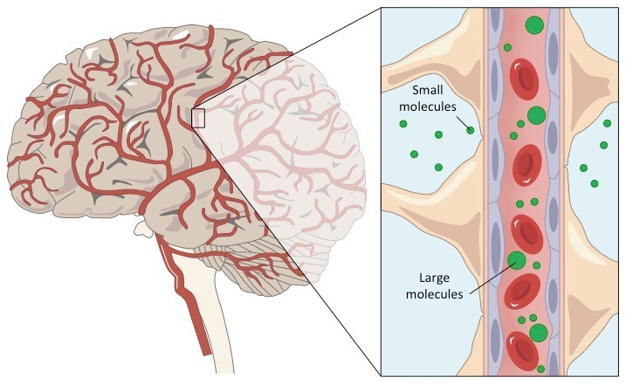
MS is an Autoimmune Disease.
“Blood Brain Barrier.” Bioninja.
Notes:
http://ib.bioninja.com.au/options/option-a-neurobiology-and/a2-the-human-brain/blood-brain-barrier.html
Multiple Sclerosis is considered an autoimmune disease. This means that the cells of the immune system attack the body, mistakenly identifying part of the body as an invading antigen. In this case the body identifies myelin as the antigen. This image shows a zoomed in section of the blood brain barrier, with the vasculature shown in the middle and the astroglia and internal areas of the brain shown on the sides.

Slide 6

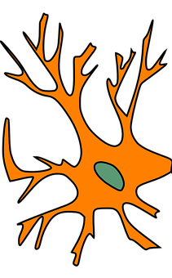
The immune system causes permanent damage to glial cells and neurons.
T-CELL
KILLER T-CELL
BLOOD
BRAIN
BARRIER
“Clinical Progression of Multiple Sclerosis.” Khan Academy, Khan Academy, www.khanacademy.org/science/health-and-
medicine/nervous-system-diseases/multiple-sclerosis/v/clinical-progression-of-multiple-sclerosis.
Notes:
This is a zoomed in image of the blood brain barrier, but flipped horizontally from the previous image. The neuron on the bottom represents a neuron inside the brain, and the molecules on the outside are immune cells in the vasculature outside the brain.
The central nervous system is typically separated from the immune system of the rest of the body, and it protects itself with a different nervous system, the “neuroimmune system”. In cases of multiple sclerosis, however, immune cells can cross the blood brain barrier and enter the brain. (ANIMATION 1). They can enter via the choroid plexus and proliferate in the cerebrospinal fluid or they can simply enter through arteries in the meninges.
There are many proteins coating the outside of the oligodendrocytes. These proteins are recognized by T-cells, a type of immune cell, that crosses the blood brain barrier. Upon the incorrect recognition of the proteins as antigens, the T-cells release cytokines (ANIMATION 2). Cytokines can help increase the permeability of the BBB and allow other immune cells inside (ANIMATION 3 +4). Other immune cells such as B-cells, which produce antibodies and target the oligodendrocyte for destruction . Once targeted for degradation, the oligodendrocytes are destroyed and digested by natural killer cells and macrophages (ANIMATION 5). The cell can then try to repair itself, but often the lesions turn into plaques of damaged myelin. (ANIMATION 6) This creates permanent damage to the myelin and eventually to the axon beneath the myelin if the repair processes cannot keep up with the damage.

Slide 7
Multiple Sclerosis causes changes in saltatory conduction.
Rose, John W., et al. “Lectures: Pathology.” Multiple Sclerosis, library.med.utah.edu/kw/ms/path.html#1.
Notes:
The damage to and loss of myelin decreases the amount of saltatory conduction possible.
Normally, myelin helps insulate the neuron and increases the distance that the passive current can flow. By increasing the distance that passive current can flow, less action potentials need to happen along the axon, making the overall action potential much faster.
With damaged or missing myelin, however, there is less insulation around the axon. This means that the passive current leaks out of the area where the myelin used to contain it. Now the passive current cannot travel as far and more action potentials need to be fired along the same length of axon. The overall action potential is now much slower and can even be distorted due to the damage.

Slide 8


What are the Symptoms of Multiple Sclerosis?
BALANCE and COORDINATION
VISUAL PROBLEMS
FATIGUE
MUSCLE PAIN and TINGLING
“Black person.” Pixabay.
“Gray Person.” Clicker Clipart.
Agamanolis, Dimitri. “Demyelinative Diseases, Chapter 6.” Neuropathology: An Illustrated Interactive Course for Medical Students and Residents, neuropathology-web.org/chapter6/chapter6aMs.html.
Notes:
“The demyelination of the neurons and eventual damage to the axon itself leads to a variety of physical symptoms. The slower and distorted action potentials often create difficulties with movement and muscular contraction.”
“Some of the main symptoms include: fatigue, walking difficulties, visual problems, and muscle pain/tingling. Although symptoms tend to vary frequently between individuals. And many symptoms are possible depending on individual differences”
https://pixabay.com/vectors/men-s-locker-room-man-human-toilet-155828/ (person, black)
http://www.clker.com/clipart-man-aiga-gray.html (person, gray)

Slide 9

How does MS Progress?
Relapsing Remitting MS
Severity
“Orange MS Ribbon.” Pinterest.
Time
“Clinical Progression of Multiple Sclerosis.” Khan Academy, Khan Academy, www.khanacademy.org/science/health-and-
medicine/nervous-system-diseases/multiple-sclerosis/v/clinical-progression-of-multiple-sclerosis.
Notes:
In addition to the varying symptoms, there are varying types of disease progression. There are four different types of MS that all have different characteristic patterns of progression. About 85% of all MS cases fall under the category of “Relapsing Remitting MS”. This is the type of MS most treatment is targeted towards, so I will focus on this type only.
Relapsing Remitting MS progresses in a cyclical pattern. It begins with a period of increased inflammation and symptom flare up (ANIMATION ONE). Then, the inflammation stops and repair within the cells can occur (ANIMATION TWO). Finally, there is a period of stability where there is no more repair but there is also no inflammation (ANIMATION THREE). These three stages repeat over and over throughout the progression of the disease (ANIMATION FOUR).
Ribbon: https://www.pinterest.com/pin/546202261031430109/

Slide 10


Treatment options target the symptoms, not the source…
“Corticosteroids.” Healthy Place.
“Physical Therapy for MS.” Behance.
Mayo Clinic Staff. “Multiple Sclerosis.” Mayo Clinic, Mayo Foundation for Medical Education and Research, 4 Aug. 2017, www.mayoclinic.org/diseases-conditions/multiple-sclerosis/diagnosis-treatment/drc-20350274.
And we still have a lot of progress to make.
Notes:
Based on all of the research performed to study the cellular degradation and disease progression, we have developed a few main treatment options for Relapsing Remitting MS. Treatment options typically focuses on speeding up recovery, slowing the progression of the inflammation, and managing symptoms.
Corticosteroids: reduce nerve inflammation
Physical Therapy: stretching and strength exercises can help manage weakness
Concluding Slide: ”who cares”
Links:
https://www.behance.net/gallery/66605721/Multiple-Sclerosis-Awareness-Month-Posterlogo
https://www.mayoclinic.org/diseases-conditions/multiple-sclerosis/diagnosis-treatment/drc-20350274
PT image: https://www.mayoclinic.org/diseases-conditions/multiple-sclerosis/diagnosis-treatment/drc-20350274
Pills image: https://www.healthyplace.com/thought-disorders/schizoaffective-disorder-information/schizoaffective-disorder-medications-types-side-effects

Slide 11
Where do we go from here?
Treatment Options
Cellular Degradation
Symptoms
Progression
CURE!
Notes:
“Multiple sclerosis is a chronic disease of the immune system that impacts millions of people worldwide. So the processes of cellular degradation, symptoms, and disease progression will be important as we continue to search for a CURE!”
Picture Citation:
https://advancethecure4ms.org/

Slide 12
References
Agamanolis, Dimitri. “Demyelinative Diseases, Chapter 6.” Neuropathology: An Illustrated Interactive Course for Medical Students and
Residents, neuropathology-web.org/chapter6/chapter6aMs.html.
“Clinical Progression of Multiple Sclerosis.” Khan Academy, Khan Academy, www.khanacademy.org/science/health-and-
medicine/nervous-system-diseases/multiple-sclerosis/v/clinical-progression-of-multiple-sclerosis.
“It's Multiple Sclerosis Week! Tell Us What MS Means to You.” National Multiple Sclerosis Society,
main.nationalmssociety.org/site/MessageViewer?em_id=68686.0&dlv_id=86366&s_AffiliateSecCatId=1&pw_id=10481.
Mayo Clinic Staff. “Multiple Sclerosis.” Mayo Clinic, Mayo Foundation for Medical Education and Research, 4 Aug. 2017,
www.mayoclinic.org/diseases-conditions/multiple-sclerosis/diagnosis-treatment/drc-20350274.
“MS Symptoms.” National Multiple Sclerosis Society, www.nationalmssociety.org/Symptoms-Diagnosis/MS-Symptoms.
Rose, John W., et al. “Lectures: Pathology.” Multiple Sclerosis, library.med.utah.edu/kw/ms/path.html#1.

